Slide 1
Exploring and transforming synthetic datasets (Mini Project 1)

Slide 2

Niaz Shamsudeen ACMA,CGMA | LinkedIn

Slide 3
BUSINESS PROBLEM :
Synthetic datasets are populated with a small number of real unique observations and those limited observations are replicated thousand of times to create big data sets. As very little variation can be found on those datasets, they provide very limited insight.
There are a lot of publicly available datasets with real observations, but if someone is looking for a specific type of data sets and only the synthetic data is available, there is a need to (1) first understand that we are handling synthetic and then there is a need to (2) transform it in to a useful dataset. This project address both on a specific type of dataset – ‘online sales’
Another justification is, even if real data exist, synthetic data might be more feature rich.

Slide 4
STAKEHOLDERS :
Data Science Institutes or any other interested parties who want real like data for training purposes, but real data is not available in the respective subject area.

Slide 5
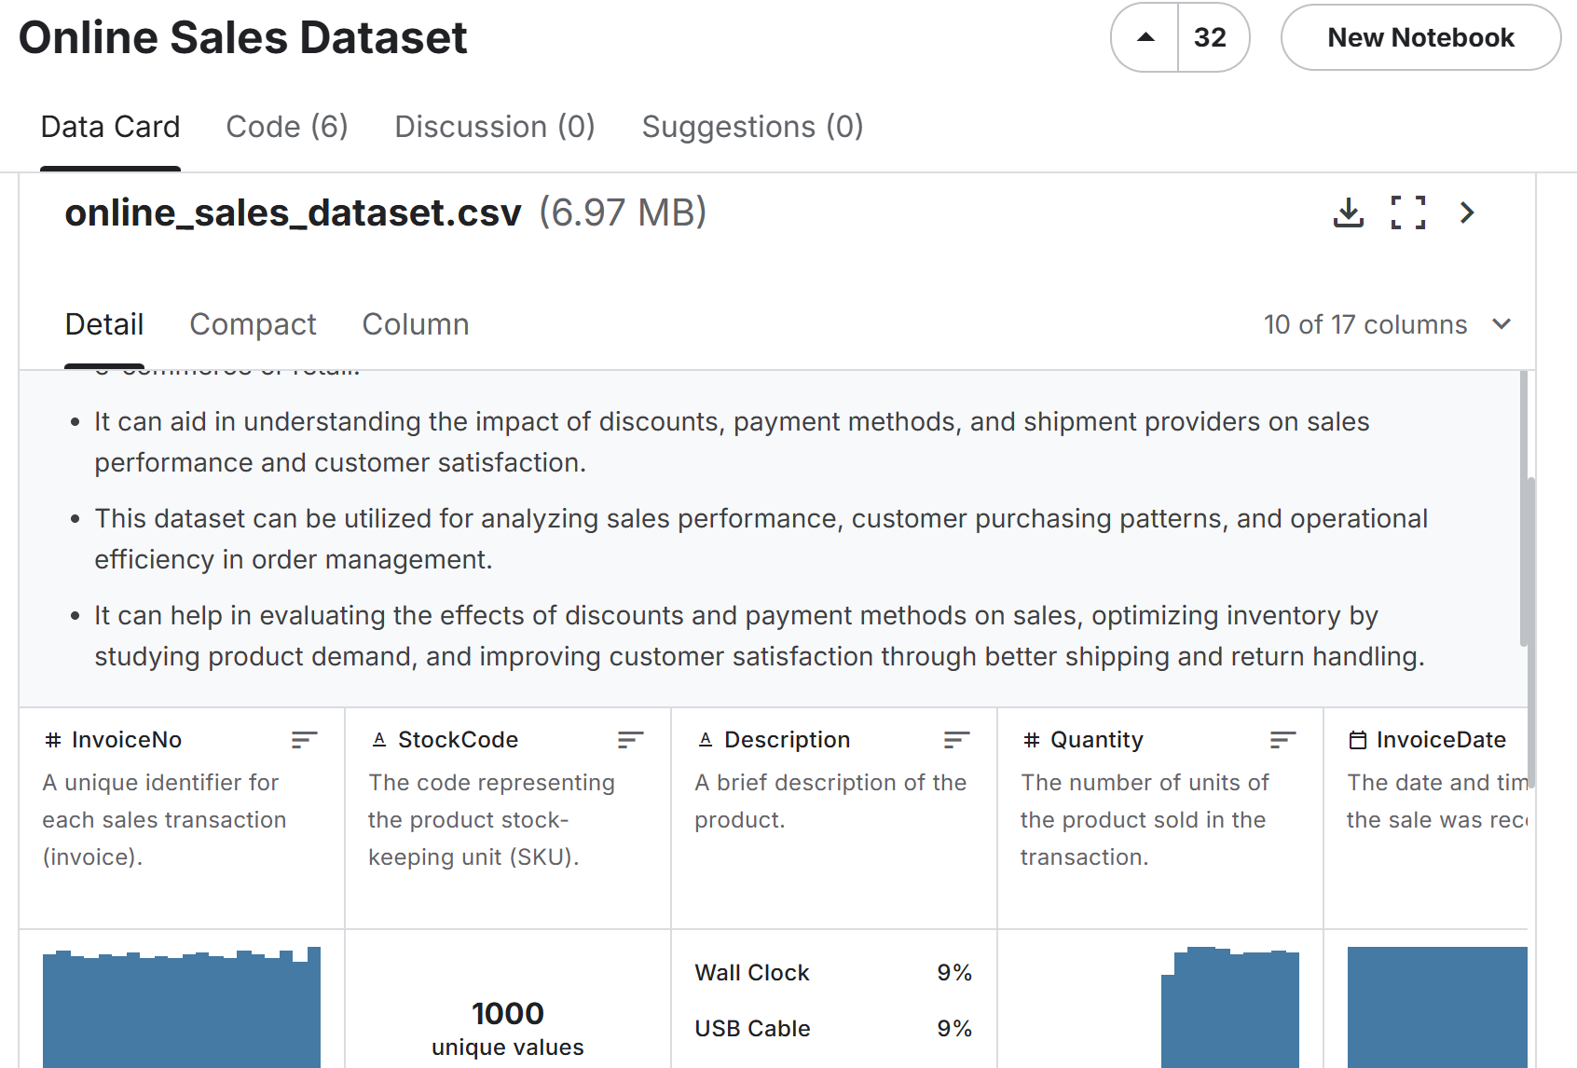
Data Source :
Online Sales Dataset

Slide 6
Approach:
Understand the dataset
Clean the dataset
Explore further
Identify whether the dataset is synthetic or not
Transform - Make ‘real data’ like variations.
Do sample EOD on Transformed data
6. Conclusion

Slide 7
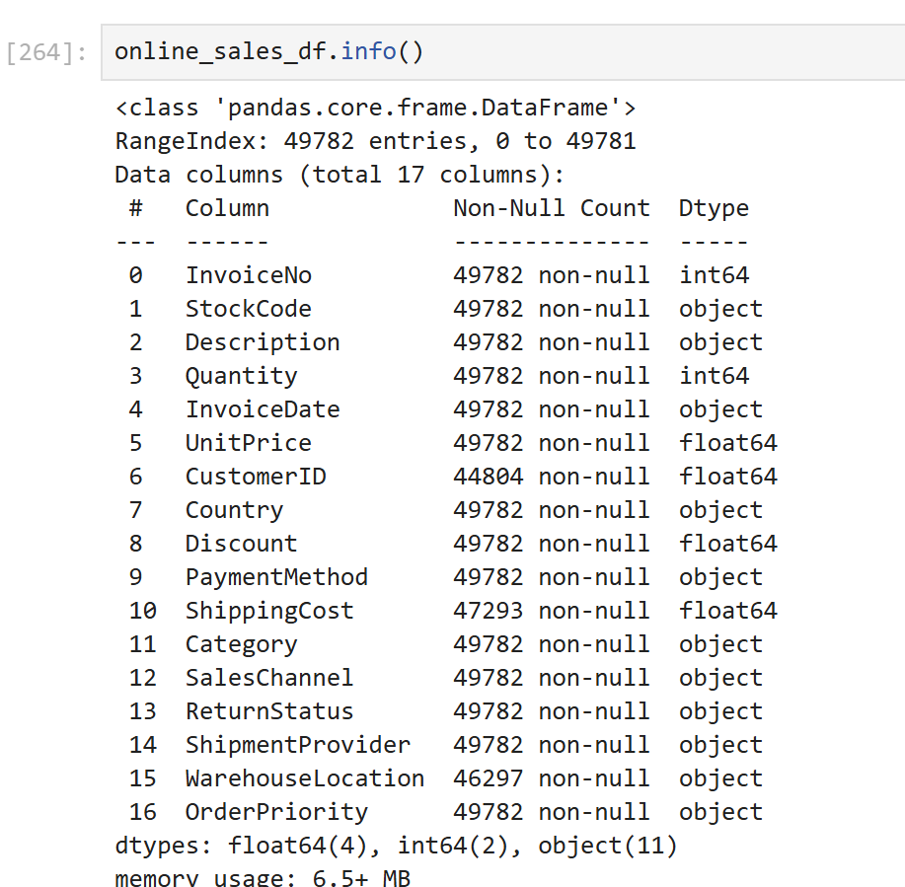
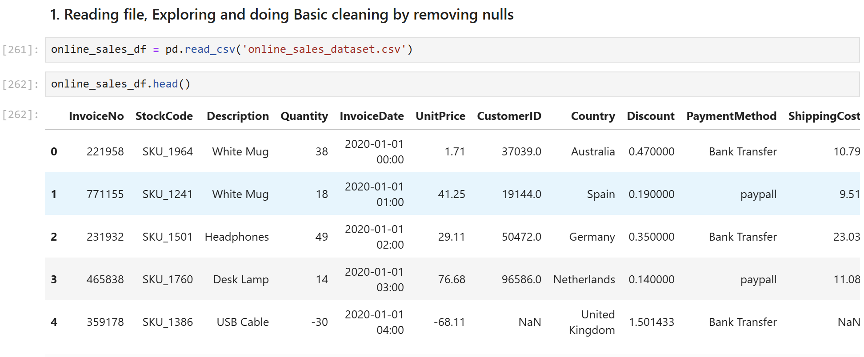
1. Understand the data set:
Read dataset in to Pandas Dataframe and do the basic data exploration
Total 49,782 observations. Observations with non null CustomerID is 44,804

Slide 8
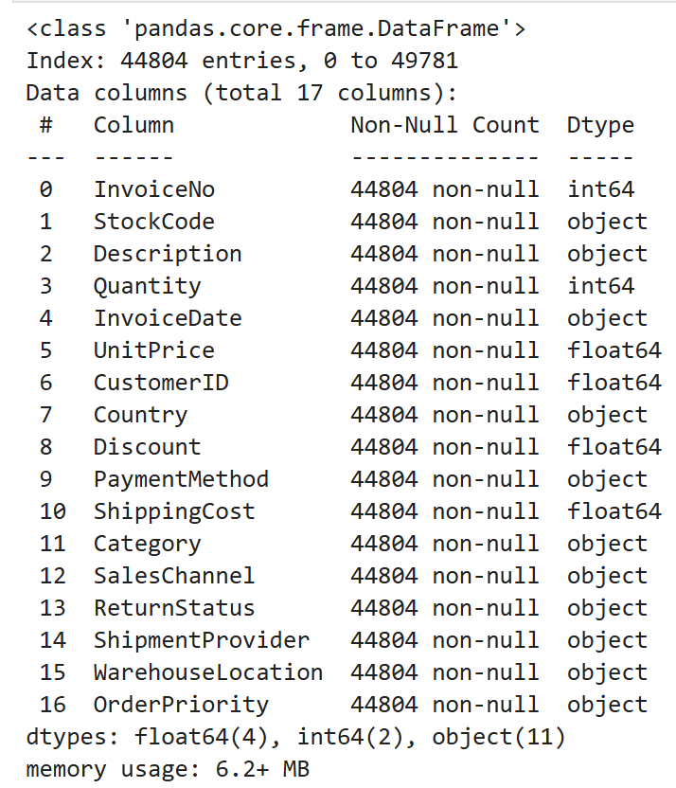
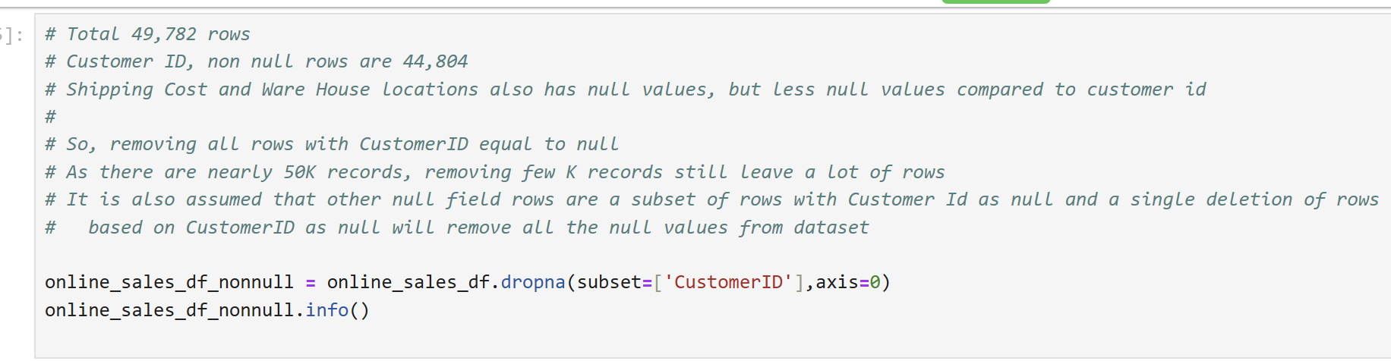
2. Clean the dataset – removing observations with null values

Slide 9
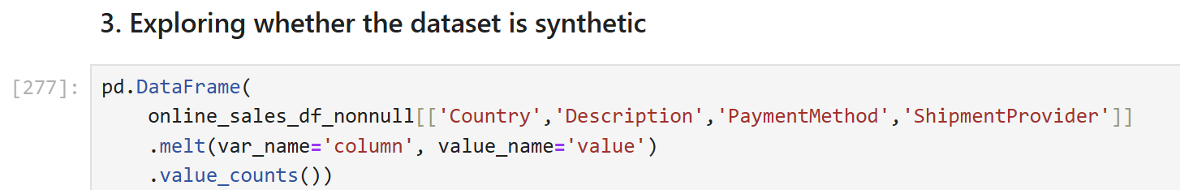
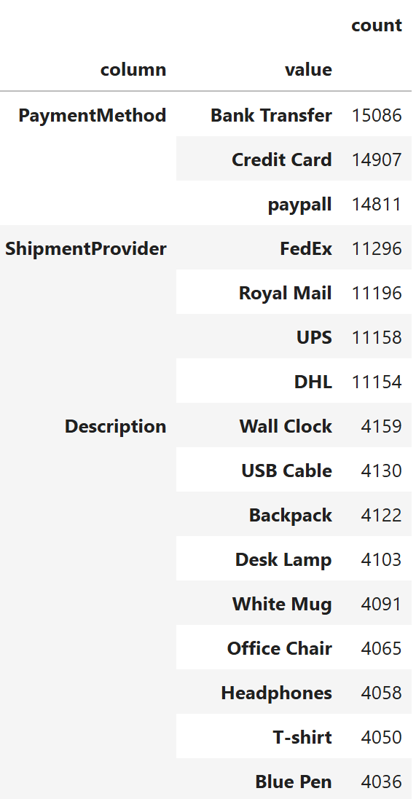
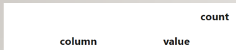
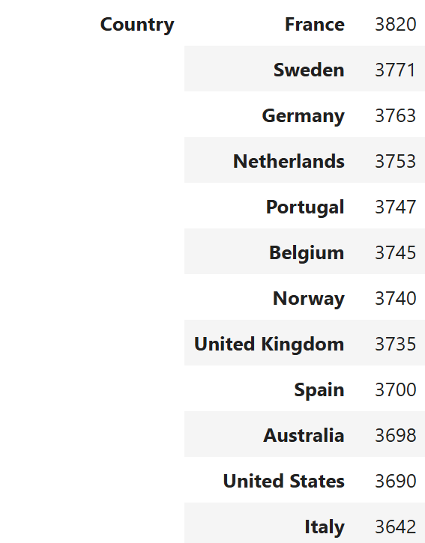
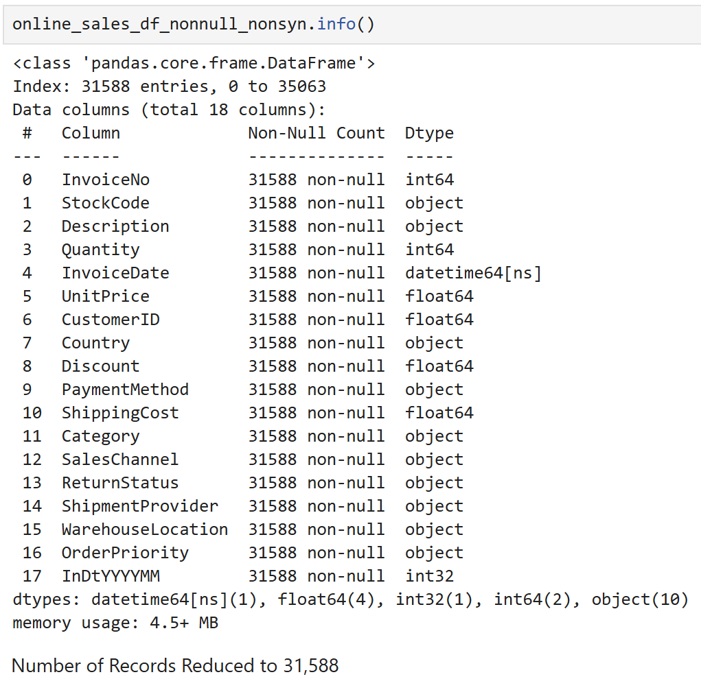
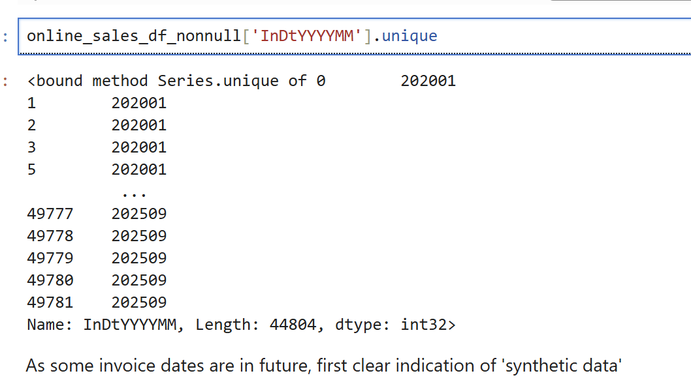
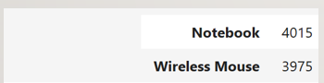
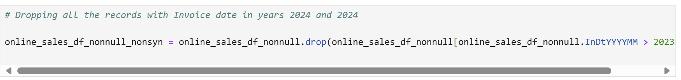
3. Explore Further – identify presence of synthetic data ……
Presence of future records is another indication of synthetic data.
Removing observations with dates in 2024 or beyond
All Payment Methods count are almost same ie nearly 15K
The same for ShipmentProvider (11K), Description (around 4K)
and Country (around 3.7K)

Slide 10
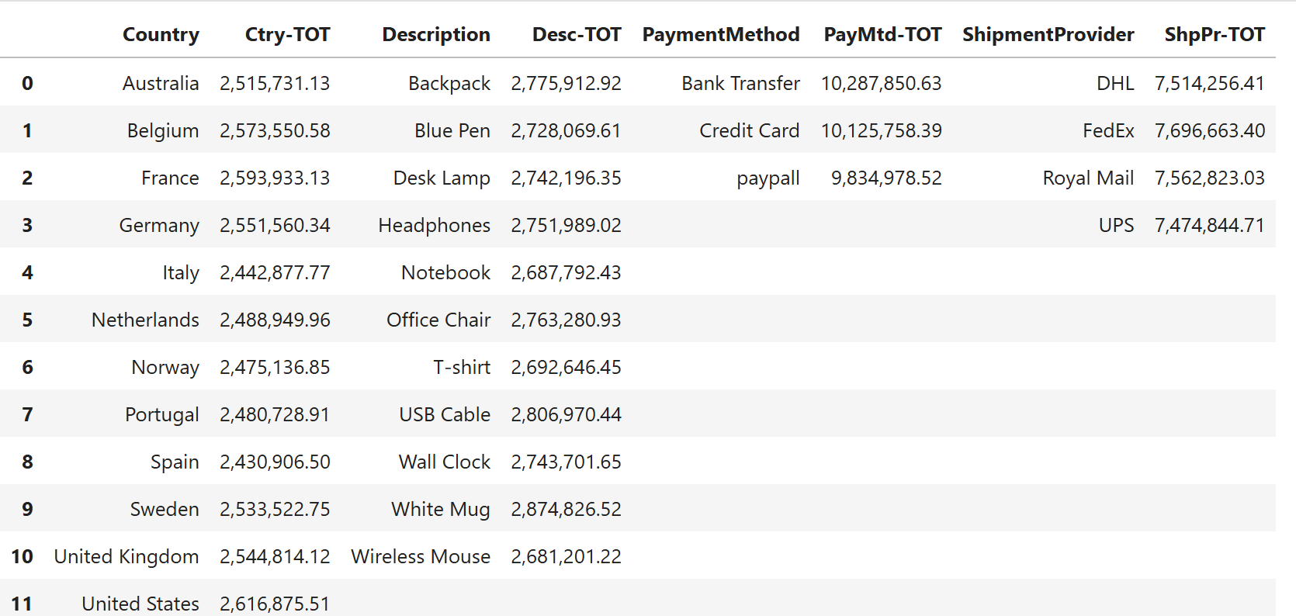
3. …… Explore Further – identify presence of synthetic data
By Country – Close to 2.5M for all countries
By Description – Close to 2.7M for all items
All Payment methods – 10M each
Shipment Provider Total – 7.5M each
Even the total calculated invoice amounts follows artificial consistency by respective column values

Slide 11
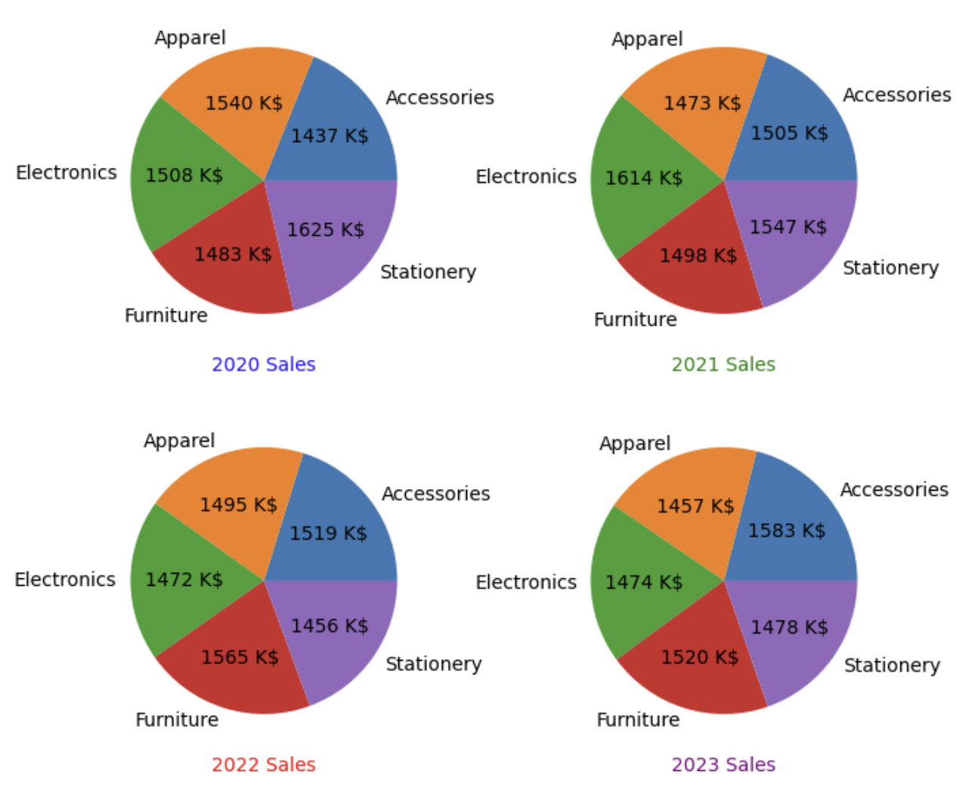
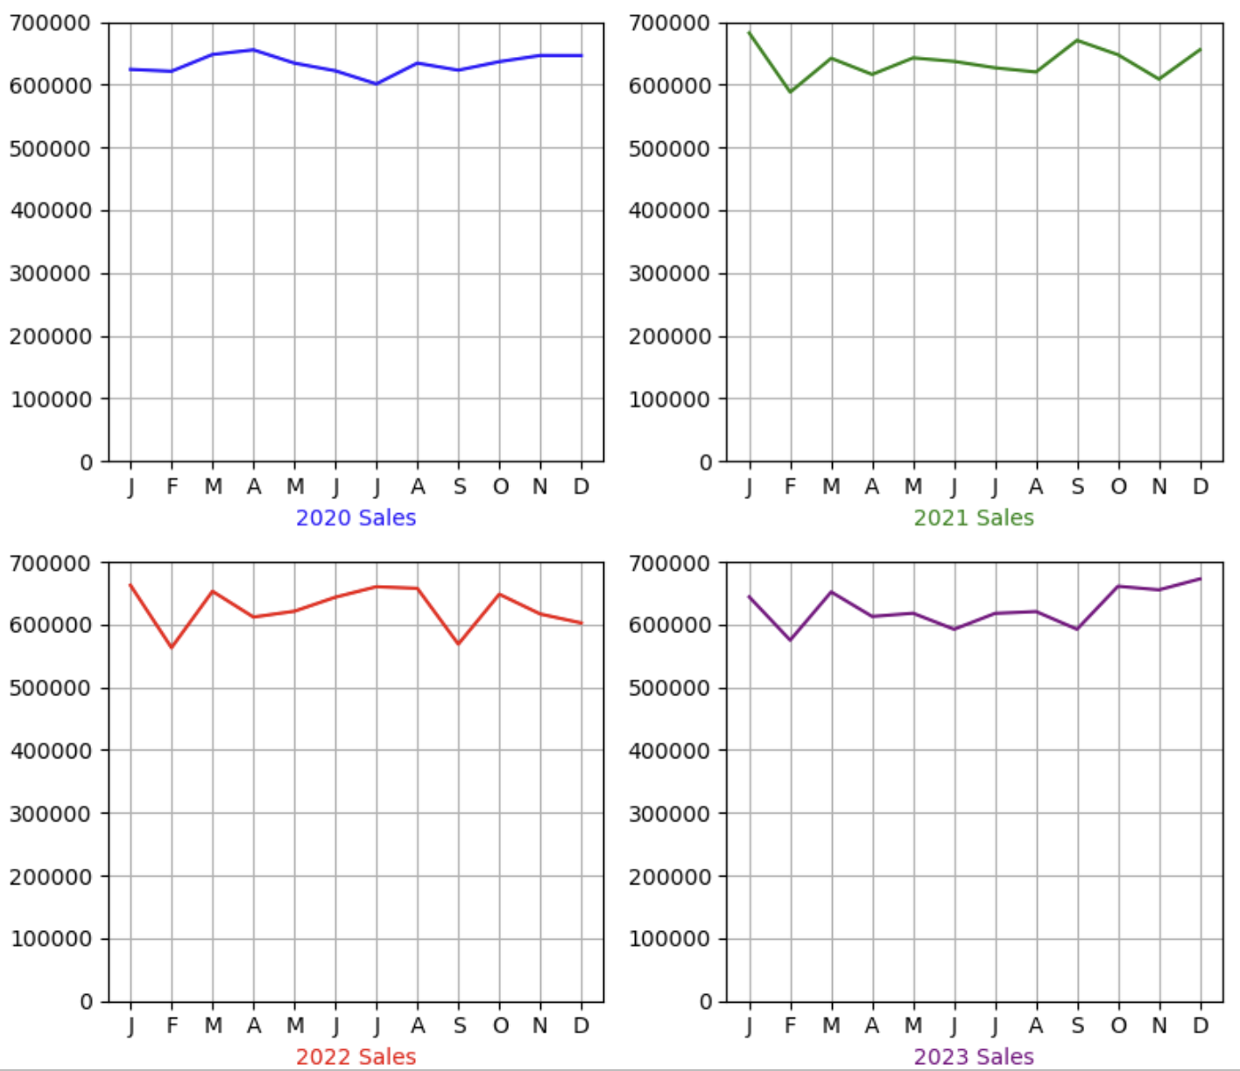
3. …… Explore Further – effect of synthetic data on visualisation

Slide 12
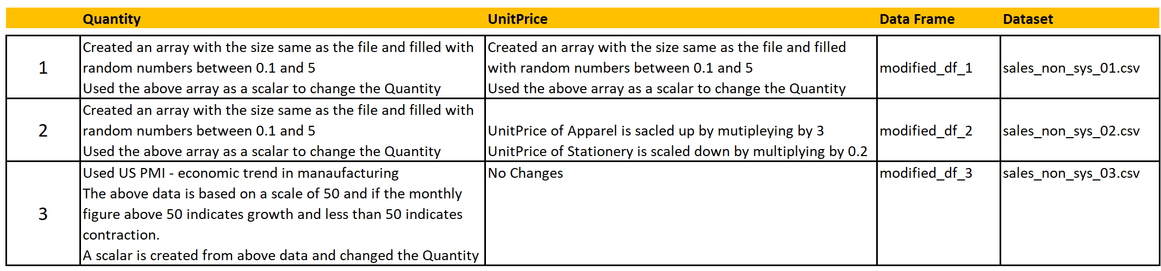
4. Transforming datasets and introduce variations
Three variations of new datasets are created from original synthetic data by making changes to two features “Quantity” and “UnitPrice”
In the Jupyter notebook they are stored in different dataframes
Finally they are written to csv files

Slide 13
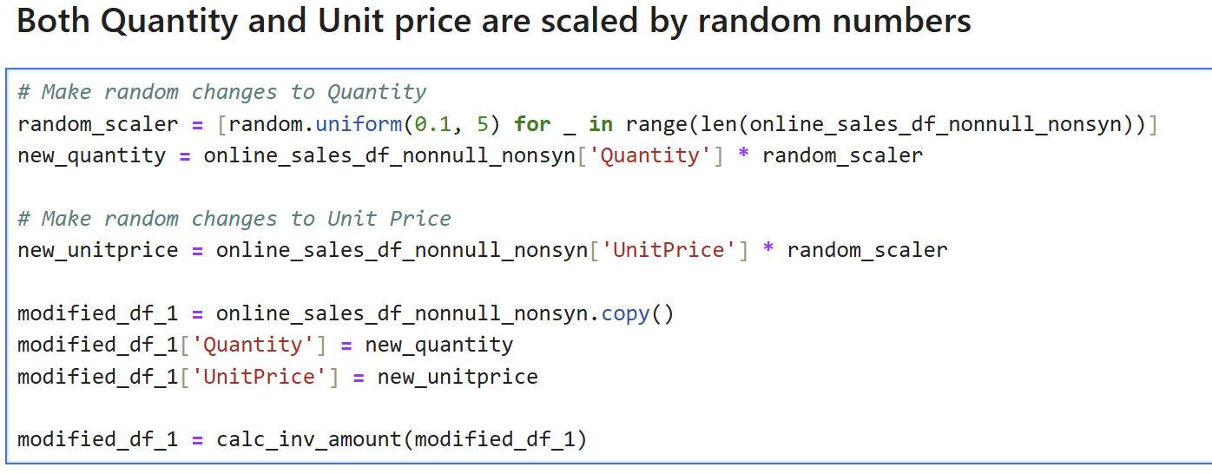
4.1 . Transforming datasets and introduce variations – First variant

Slide 14
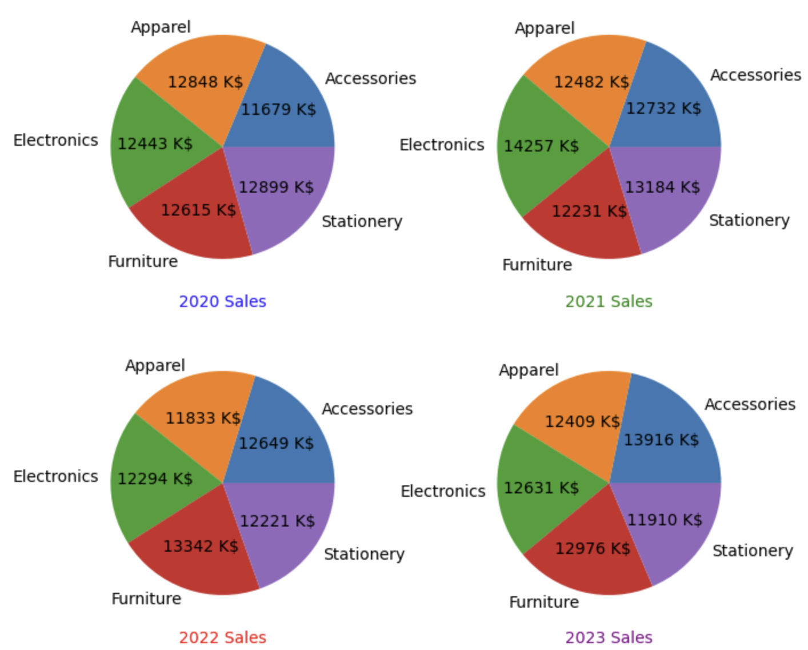
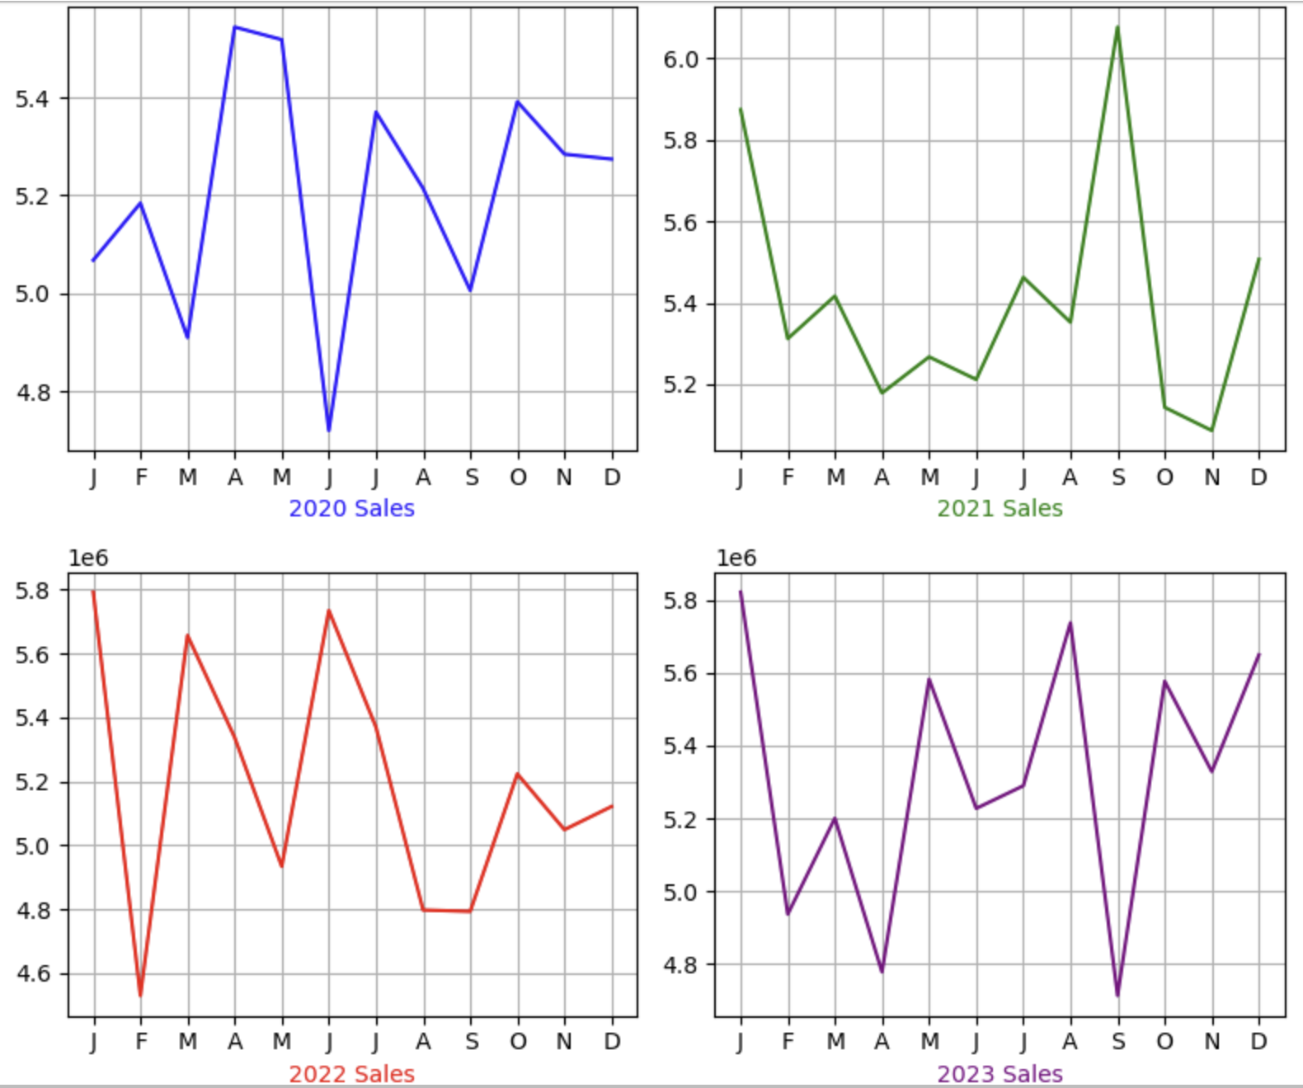
4.1 . Transforming datasets and introduce variations – First variant (Visualisation)
Category do not show much variation

Slide 15
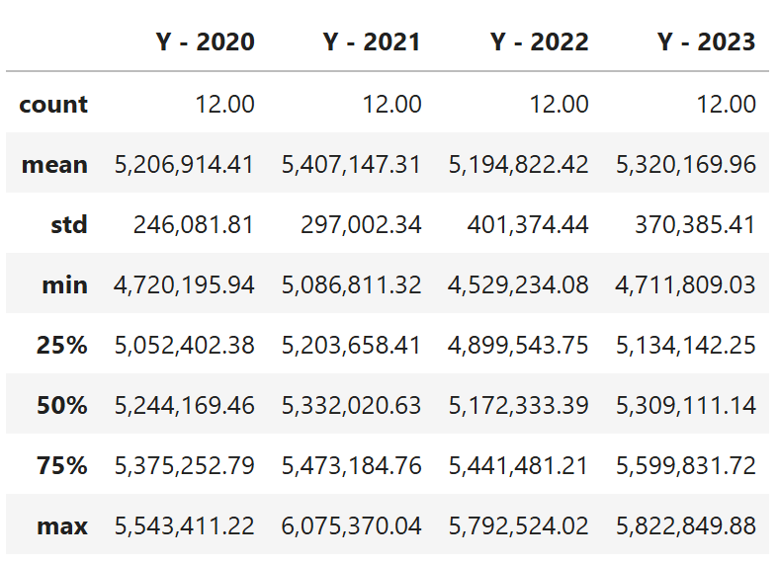
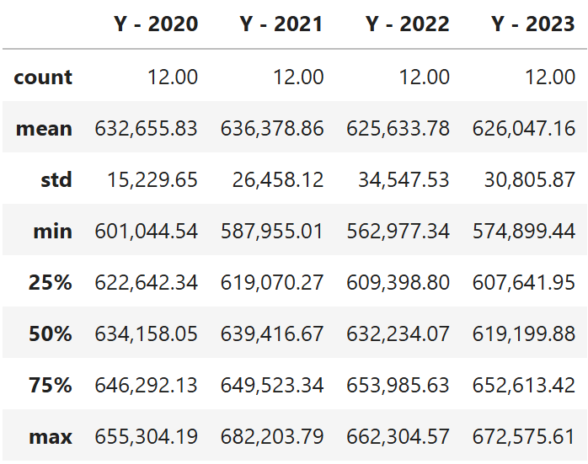
4.1 . Transforming datasets and introduce variations – First variant (Statistical summary)
Synthetic Data
Category do not show much variation

Slide 16
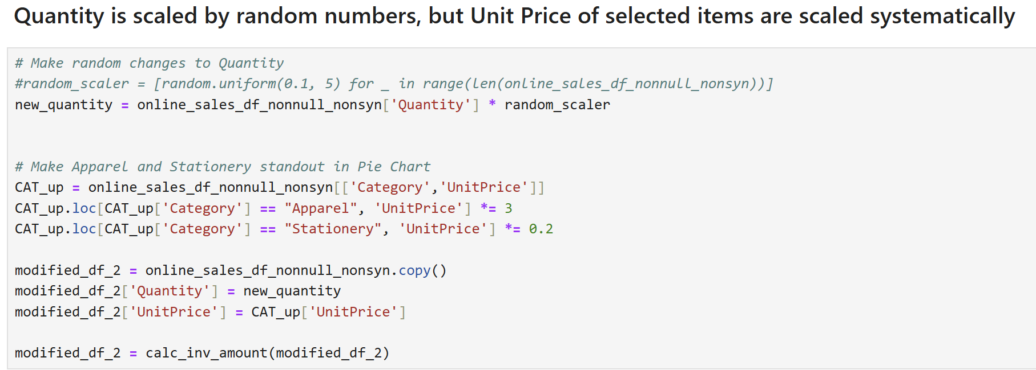
4.2 . Transforming datasets and introduce variations – Second variant

Slide 17
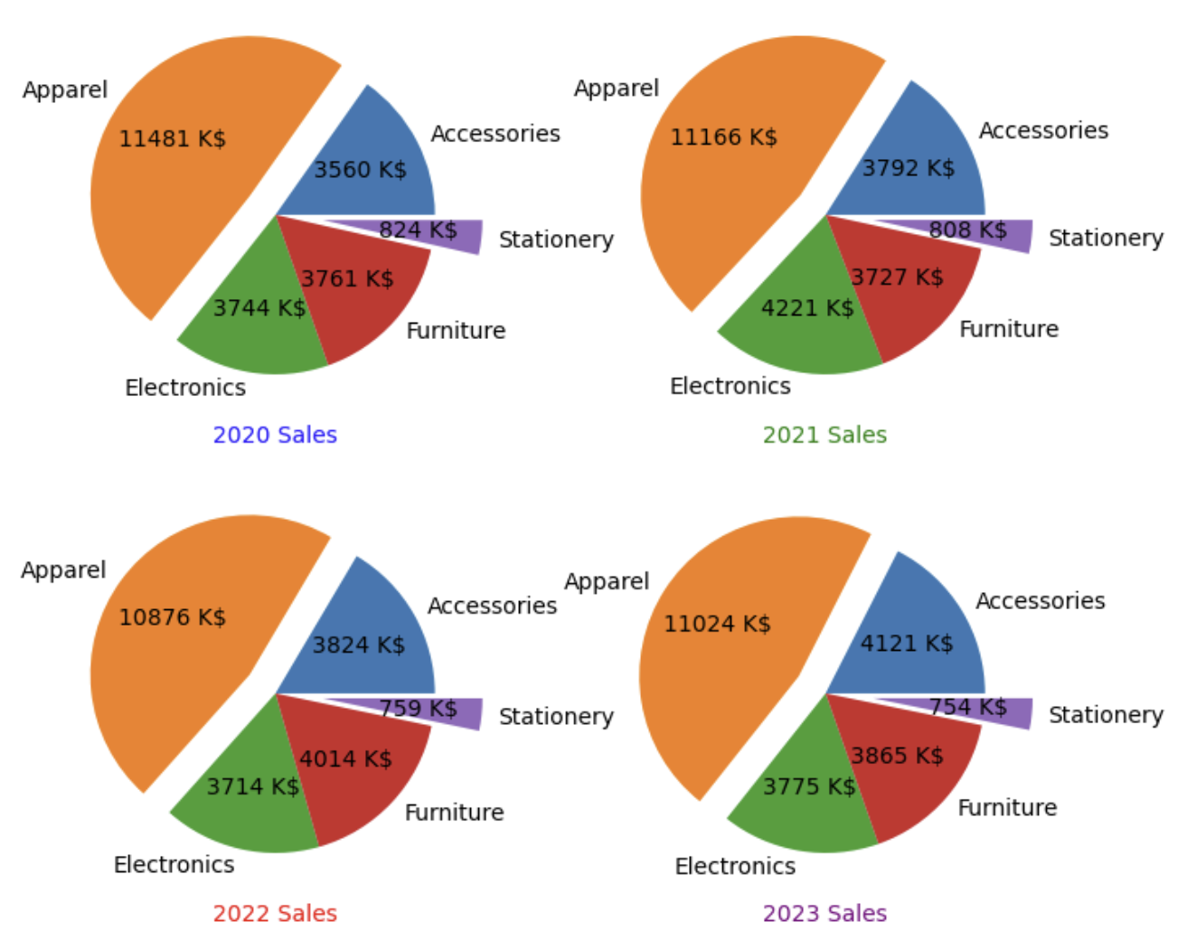
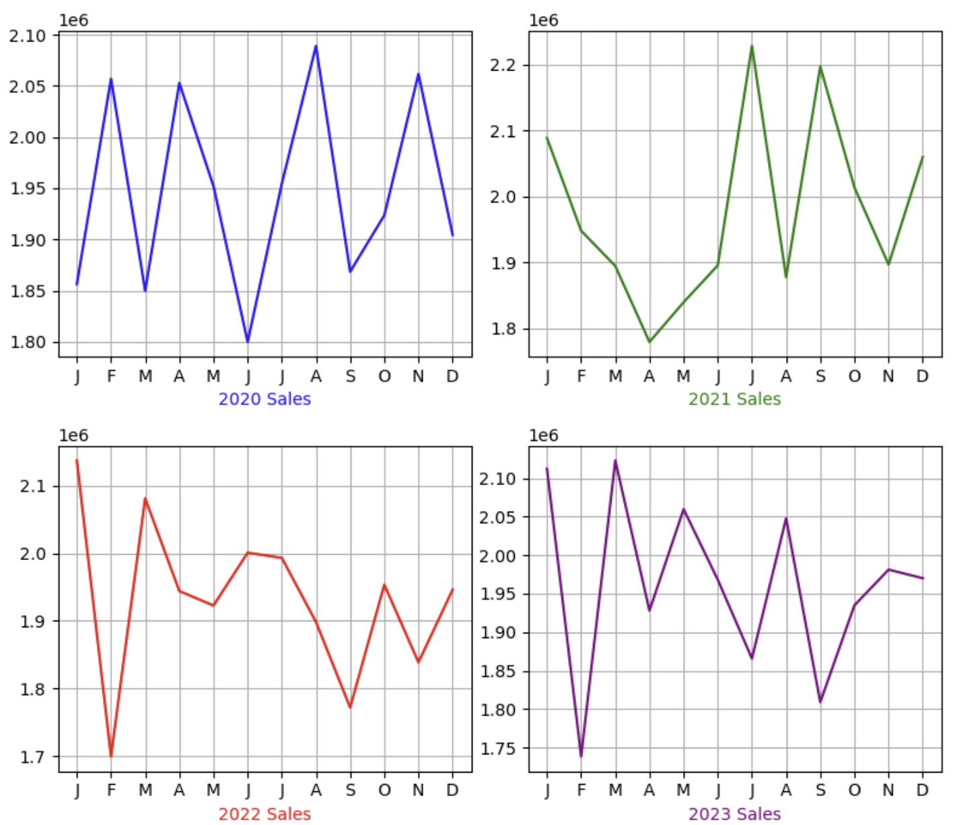
4.2 . Transforming datasets and introduce variations – Second variant (Visualisation)

Slide 18
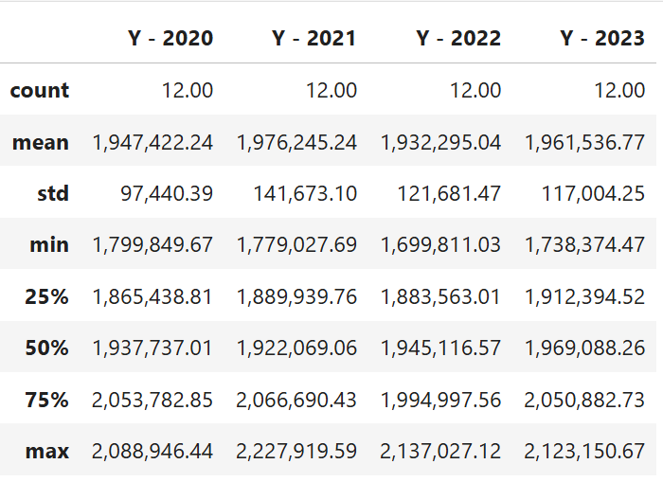
4.2 . Transforming datasets and introduce variations – Second variant (Statistical summary)
Synthetic Data
Category do not show much variation

Slide 19
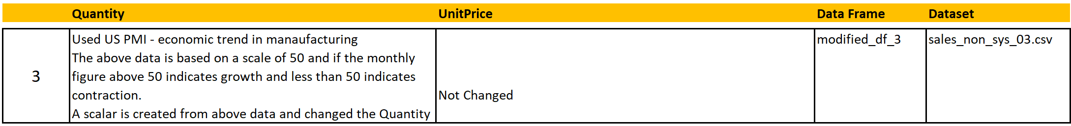
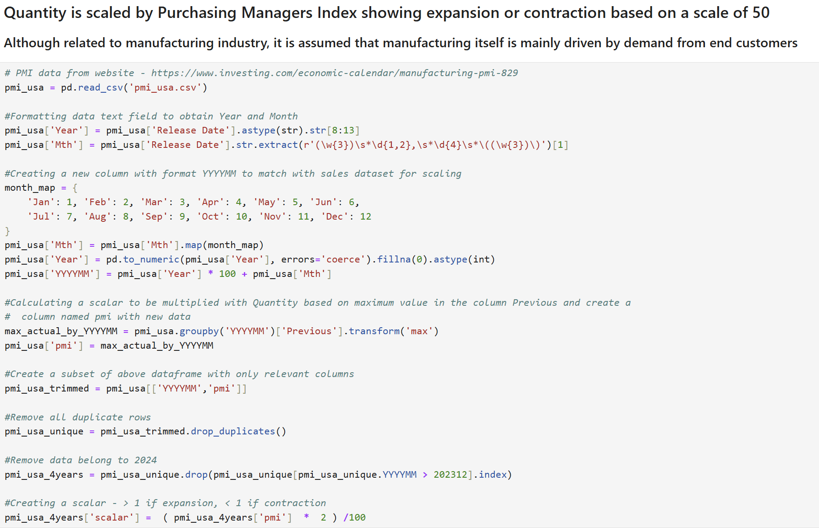
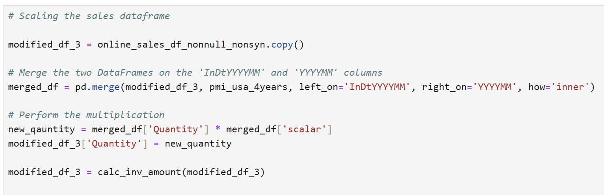
4.3 . Transforming datasets and introduce variations – Third variant

Slide 20
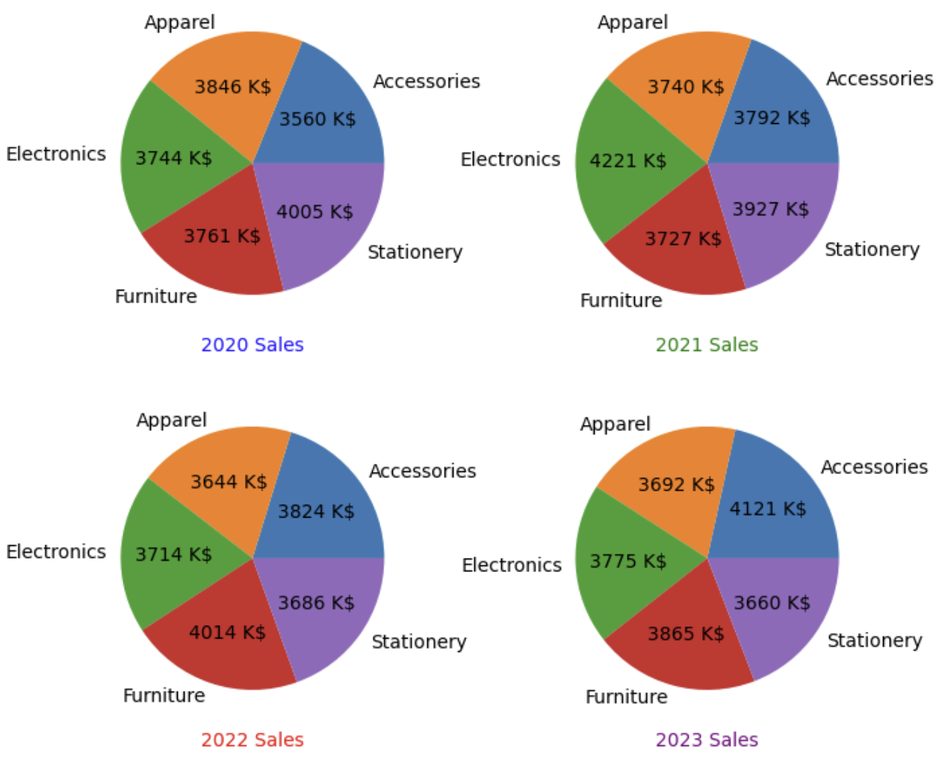
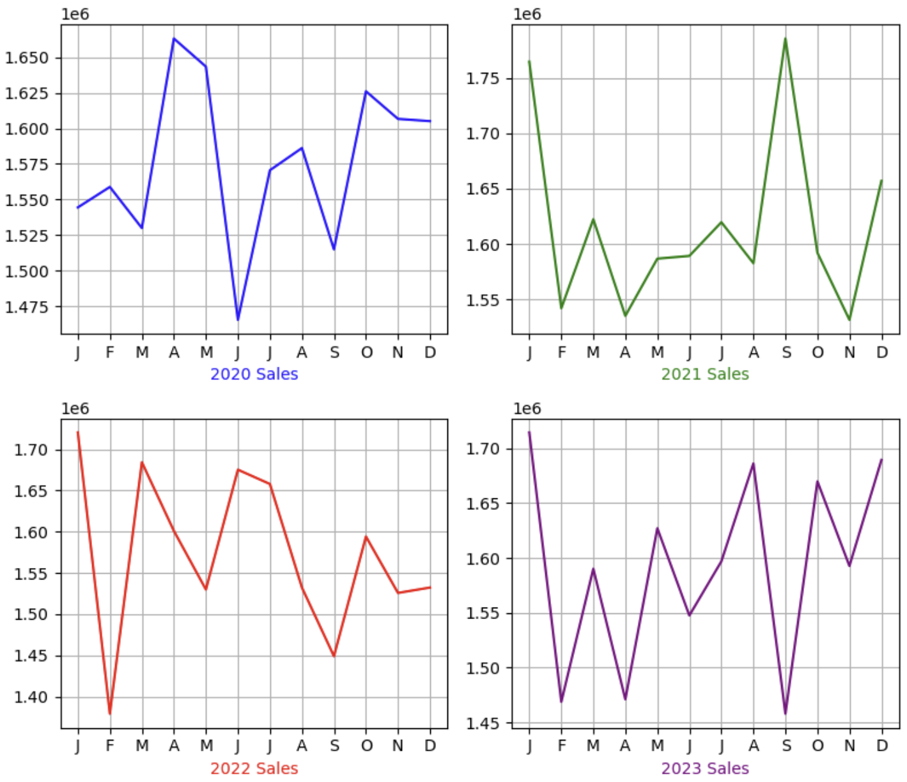
4.3 . Transforming datasets and introduce variations – Third variant (Visualisation)

Slide 21
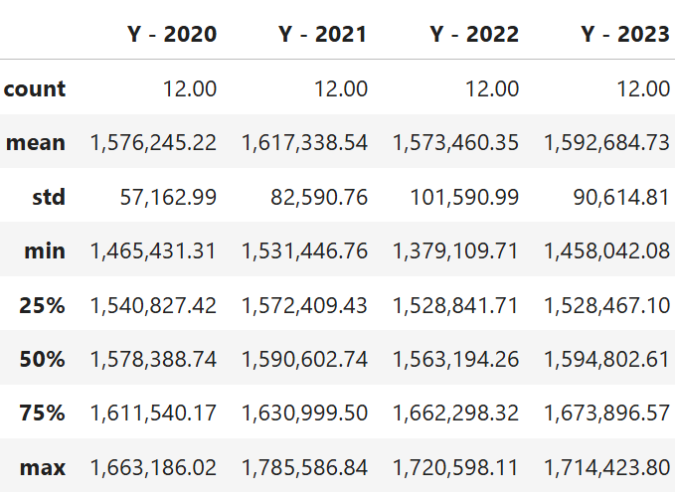
4.3 . Transforming datasets and introduce variations – Third variant (Statistical summary)
Synthetic Data

Slide 22
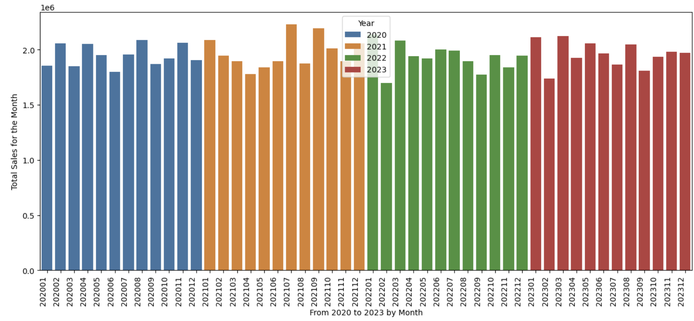
5. Exploratory Data Analysis using Transformed dataset (2nd variation)……..

Slide 23
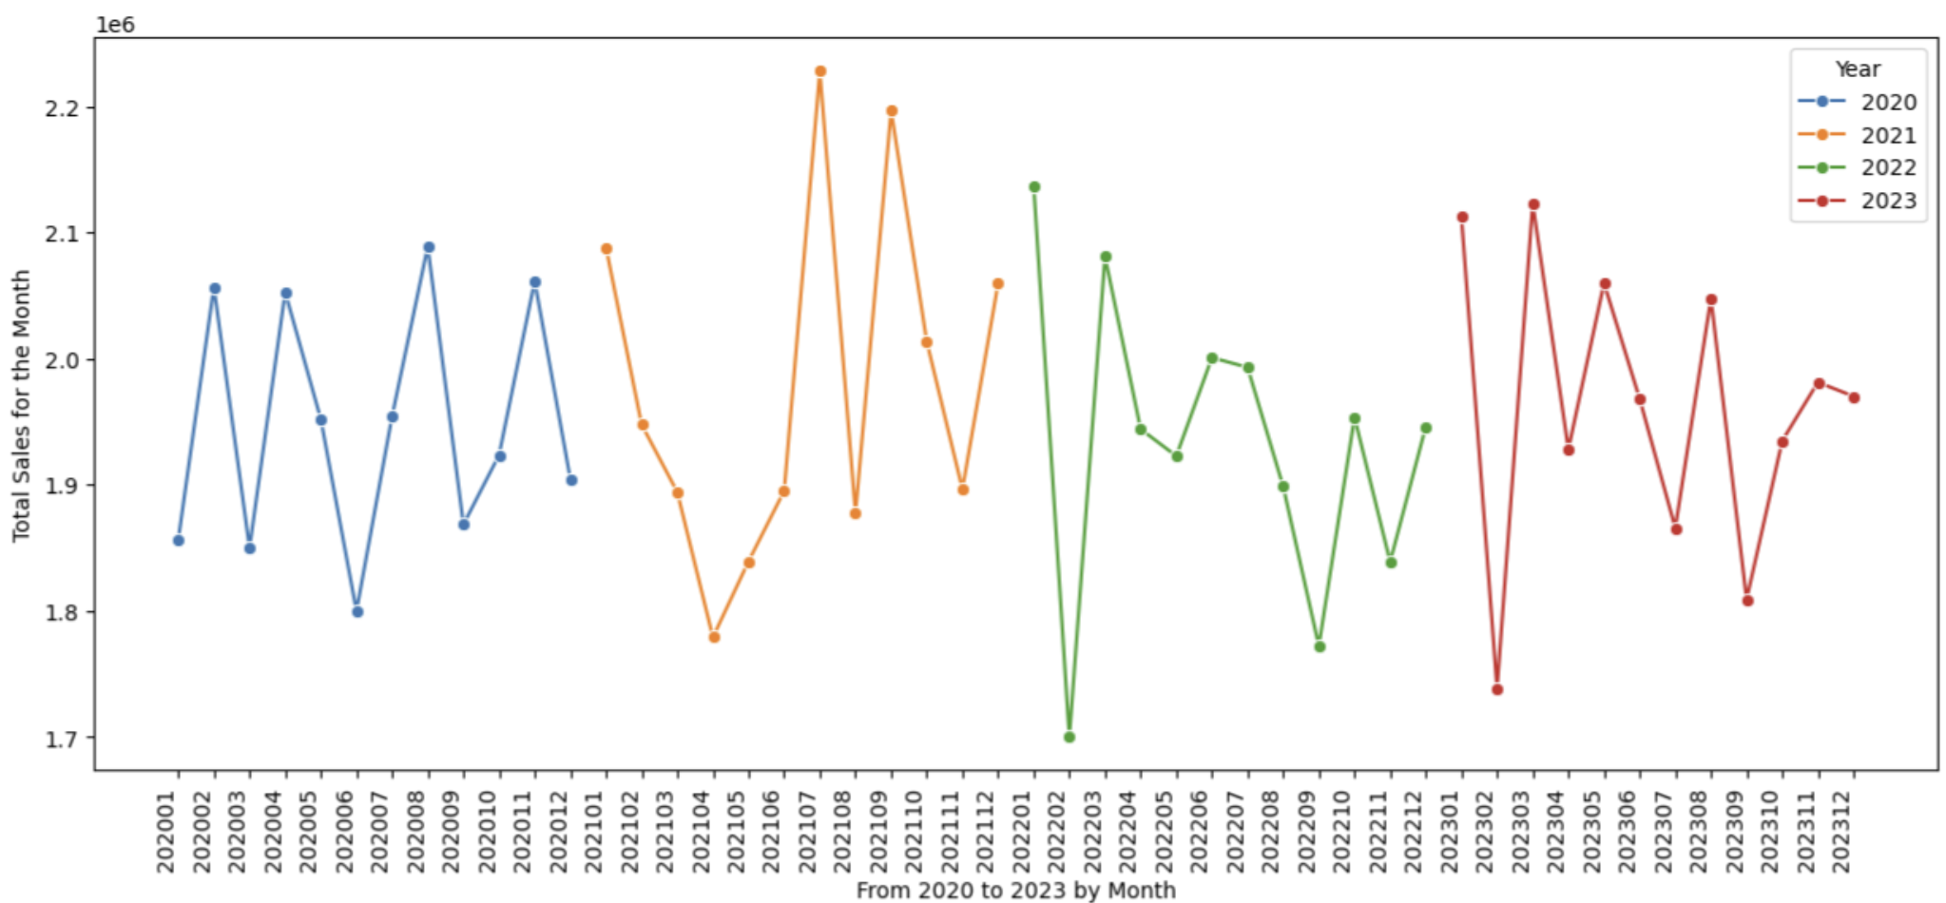
5. …..(2) Exploratory Data Analysis using Transformed dataset (2nd variation)……..

Slide 24
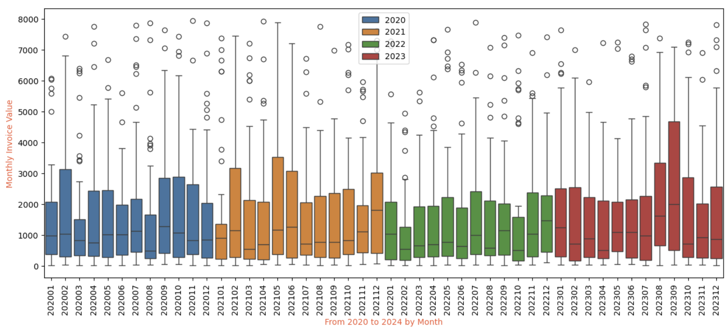
5. …..(3) Exploratory Data Analysis using Transformed dataset (2nd variation)……..

Slide 25
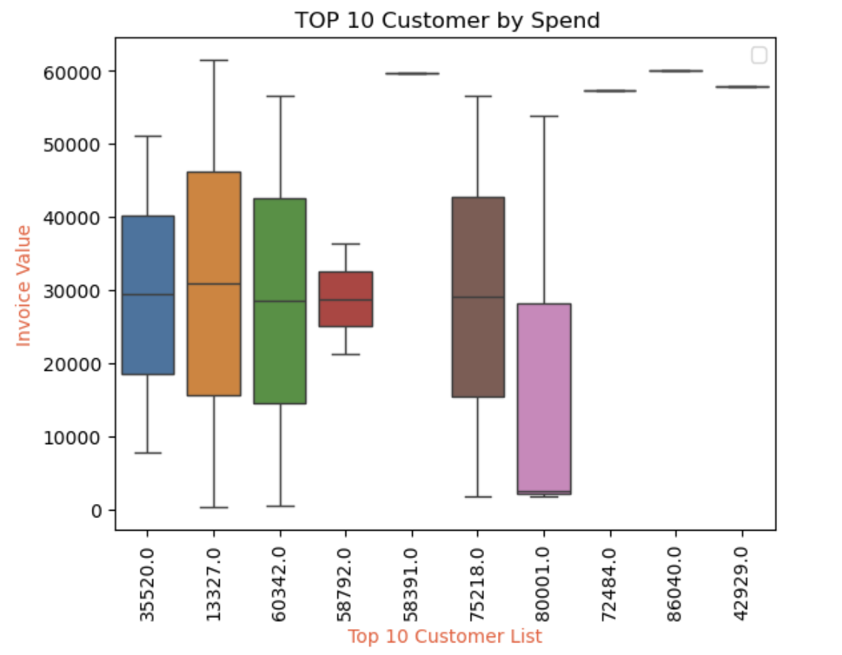
5. …..(4) Exploratory Data Analysis using Transformed dataset (2nd variation)……..
4 of them made only one purchase.
As high value spenders, potential candidate for target marketing

Slide 26
Conclusion:
By introducing variations, datasets can be used for further analysis to get business insights.
Limitation – The dataset have enough information to calculate the invoice value. But no indication of cost involved to calculate the profit margin. The profit margin per product is also not given explicitly. Any analysis done with this dataset is limited by this short coming as business decisions are mostly driven by margin/profit rather than revenue.

